Slide 1
COMPUTER GRAPHICS
LAB WORK

Slide 2

What we do with this ‘Computer Graphics’
Simply, Computer Graphics is……
Producing pictures or images using a computer

Slide 3
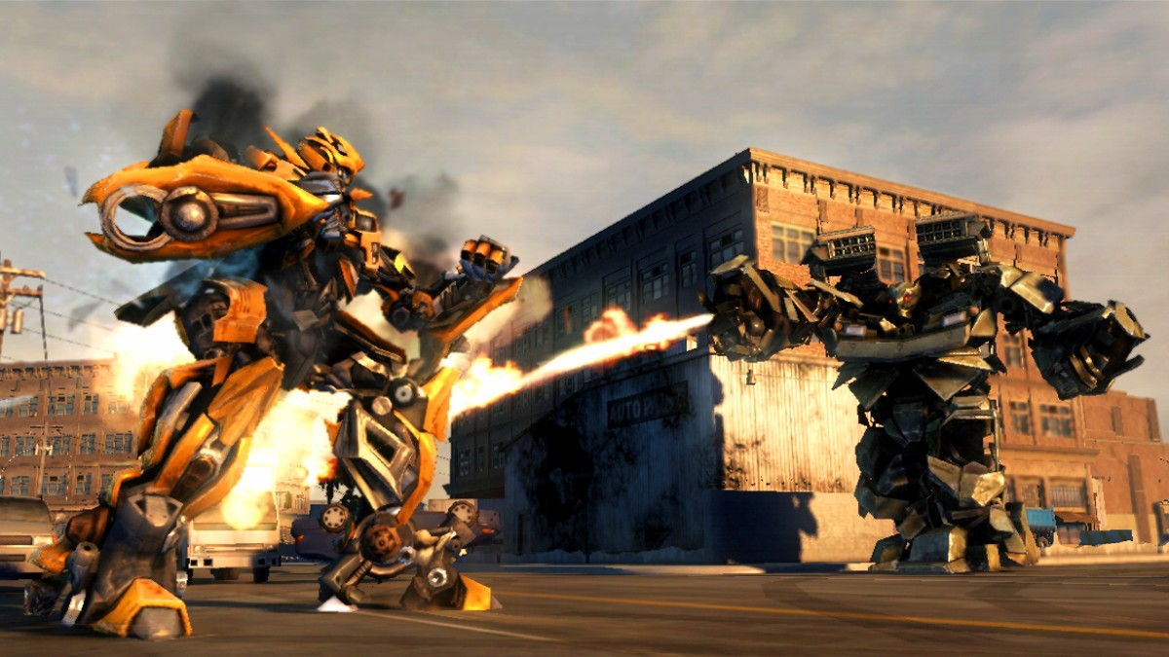
What we do with this ‘Computer Graphics’
Simply, Computer Graphics is……
Producing pictures or images using a computer

Slide 4
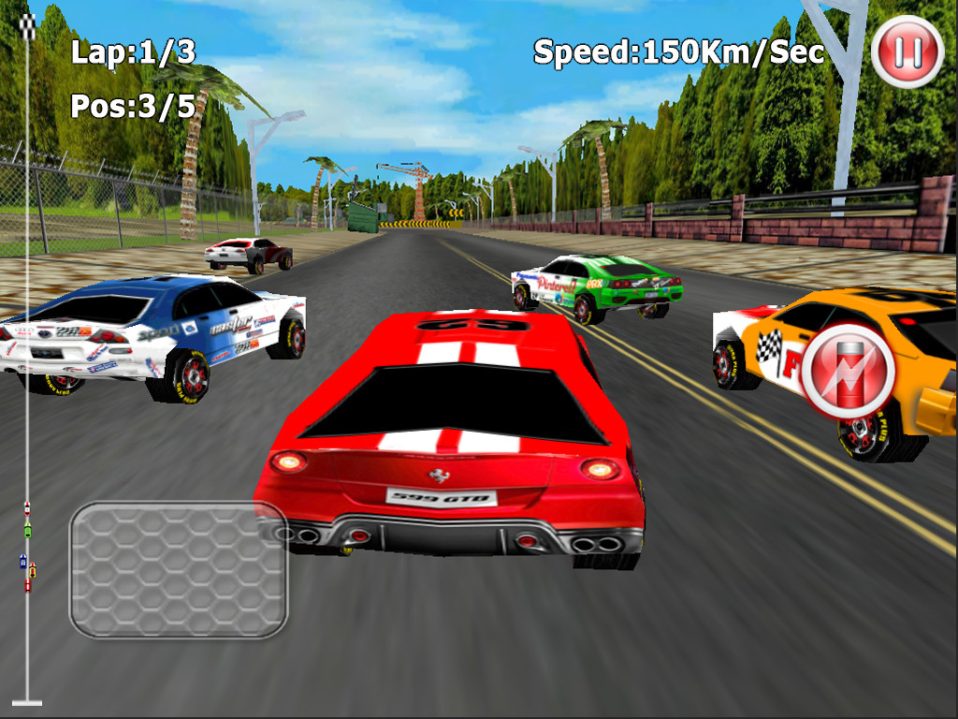
What we do with this ‘Computer Graphics’
Simply, Computer Graphics is……
Producing pictures or images using a computer

Slide 5
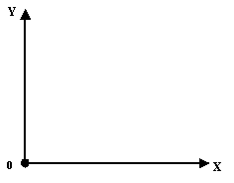
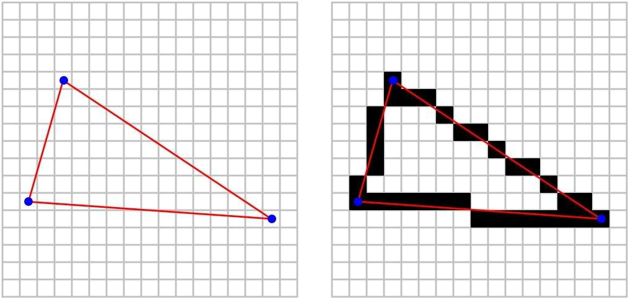
Graphics Pipeline
Representation
Transformation
Scan conversion

Slide 6

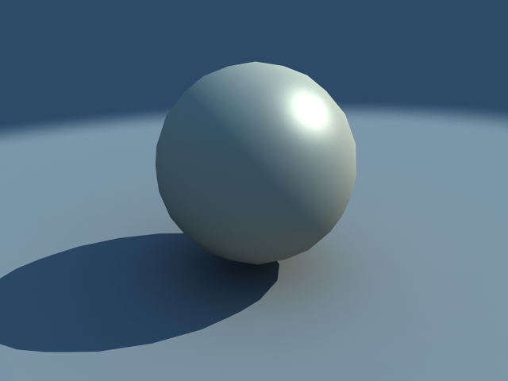
How to create realistic images?
Model it !
Define the sphere (eq: X² + Y² + Z² = R²)
Define the plane (eq….)
Define the light position (x,y)
What is the material type? (glass / rubber etc.)
Render the image !

Slide 7
basic terms
related to computer graphics

Slide 8
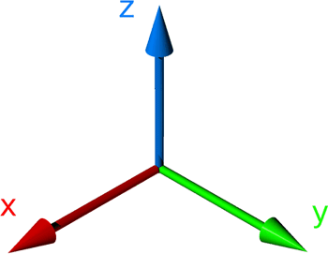
2D and 3D

Slide 9
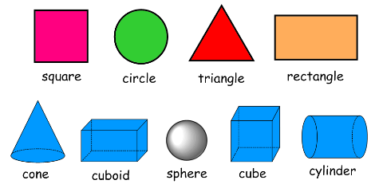
2D and 3D

Slide 10
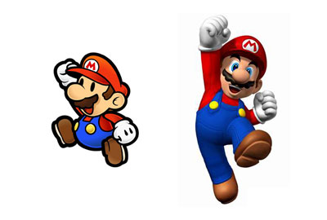
2D vs. 3D

Slide 11
‘Computer Graphics’ Definition
To be more precise,
Computer Graphics is……
Creation, Manipulation, and Storage of geometric objects (modeling) and their images (rendering)

Slide 12
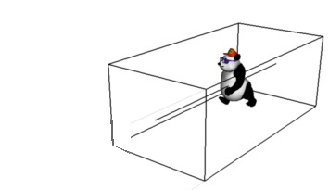
Modeling

Slide 13
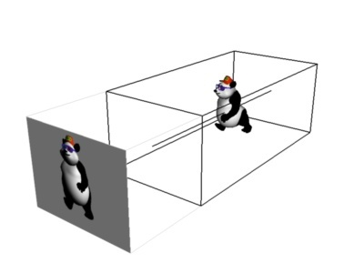

Rendering

Slide 14
openGL

Slide 15
What is openGL ?
Open Graphics Library
It's a way to draw stuff in 3D.
The graphics card is where the 3D computation happens. The purpose of OpenGL is to communicate with the graphics card about your 3D scene.
So why not talk to the graphics card directly? Each graphics card is a little different. In a sense, they all speak different "languages". To talk to them all, you can either learn all of their languages, or find a "translator" that knows all of their languages and talk to the translator, so that you only have to know one language. OpenGL serves as a "translator" for graphics cards.

Slide 16
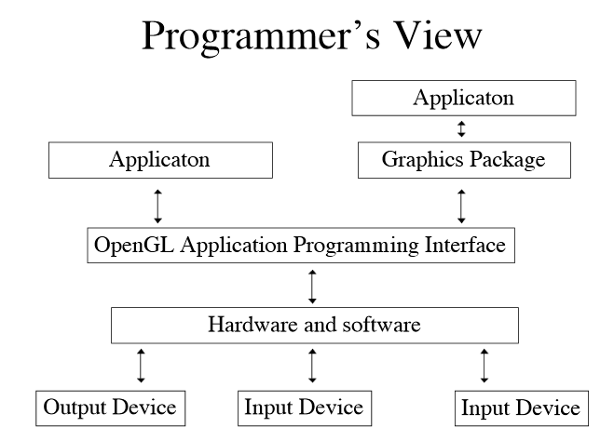
What is openGL ?

Slide 17
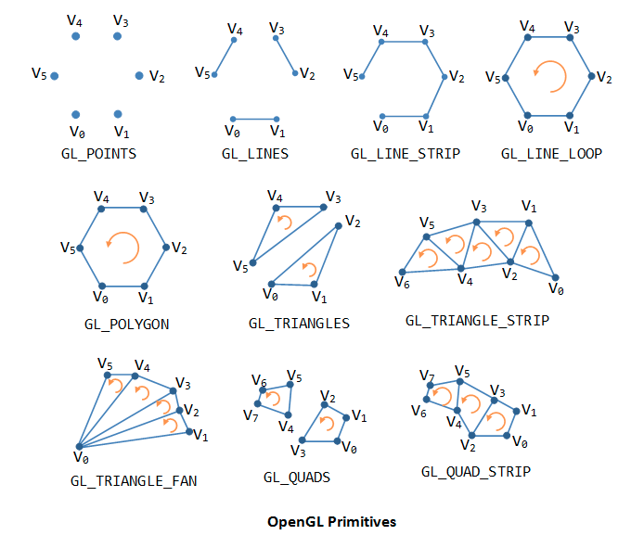
Primitives

Slide 18
OpenGL Utility Toolkit
( GLUT )

Slide 19
What is GLUT ?
The OpenGL Utility Toolkit (GLUT) is a library of utilities for OpenGL programs
GLUT makes it considerably easier to learn about and explore OpenGL programming.
GLUT provides a portable API so you can write a single OpenGL program that works across all PC and workstation OS platforms.

Slide 20
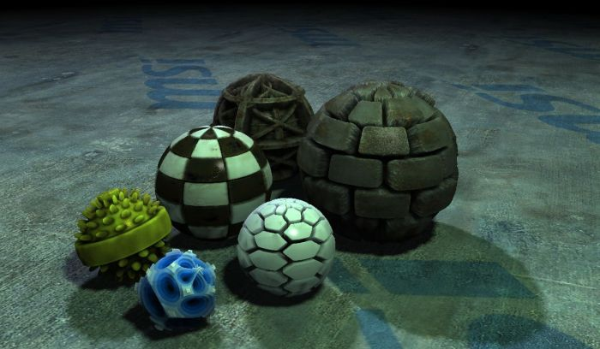
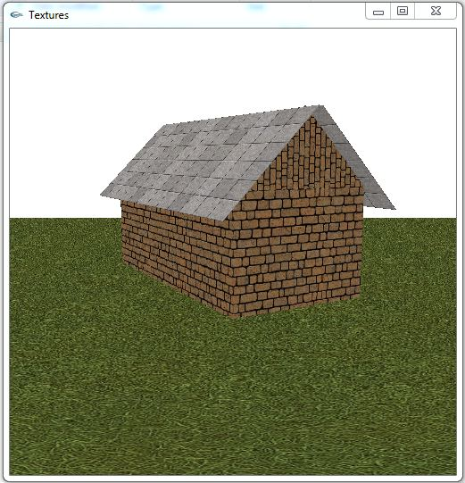
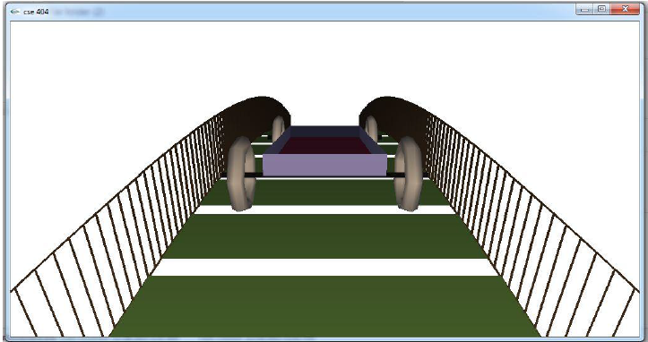

Slide 21
Let’s Start

Slide 22

Lets configure openGL in our PC !
Available at VUES
DOWNLOAD THEM

Slide 23

Lets configure openGL in our PC !
Copy them to ……
For 64 – bit Windows
C:\ Program Files(x86)\ Microsoft SDKs\ Windows\ v7.0A\ Include\ gl
C:\ Program Files(x86)\ Microsoft SDKs\ Windows\ v7.0A\ Lib
C:\windows\SysWOW64

Slide 24
Lets configure openGL in our PC !
Copy them to ……
For 32 – bit Windows
C:\ Program Files\ Microsoft SDKs\ Windows\ v7.0A\ Include\ gl
C:\ Program Files\ Microsoft SDKs\ Windows\ v7.0A\ Lib
C:\windows\System32

Slide 25
Lets configure openGL in our PC !
Alternative…
Create a project
Right click → properties
C/C++ → Additional include directories → add the path of the downloaded glut.h
Go to linker → General → Additional Library Dependencies → add the path of the downloaded glut32.lib
Go to linker → Input → Additional Dependencies → add glut32.lib
Make sure that you have glut32.dll in C:\windows\SysWOW64. If it is not there, paste it !

Slide 26
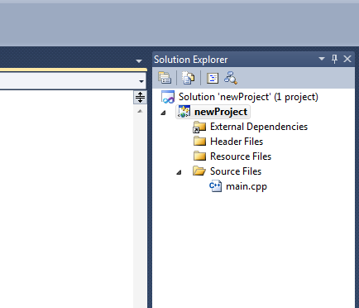
How to code?
Just create a new empty project …..
There are some built-in things for you, which makes coding easier ☺ !
Let’s know about those.

Slide 27
Lets explain our first code
#include <glut.h>
void Draw( ) {
………………………………….
}
void Initialize( ) {
……………………………………….
}
int main(int iArgc, char** cppArgv) {
……………………………………
}

Slide 28
#include <glut.h>
void Draw( ) {
………………………………….
}
void Initialize( ) {
……………………………………….
}
int main(int iArgc, char** cppArgv) {
……………………………………
}

Slide 29
int main(int iArgc, char** cppArgv)
{
glutInit(&iArgc, cppArgv);
glutInitDisplayMode(GLUT_SINGLE | GLUT_RGB);
glutInitWindowSize(250, 250);
glutInitWindowPosition(200, 200);
glutCreateWindow("CSE_404");
Initialize();
glutDisplayFunc(Draw);
glutMainLoop();
return 0;
}

Slide 30
int main(int iArgc, char** cppArgv)
{
glutInit(&iArgc, cppArgv);
glutInitDisplayMode(GLUT_SINGLE | GLUT_RGB);
glutInitWindowSize(250, 250);
glutInitWindowPosition(200, 200);
glutCreateWindow("CSE_404");
Initialize();
glutDisplayFunc(Draw);
glutMainLoop();
return 0;
}
program arguments

Slide 31
int main(int iArgc, char** cppArgv)
{
glutInit(&iArgc, cppArgv);
glutInitDisplayMode(GLUT_SINGLE | GLUT_RGB);
glutInitWindowSize(250, 250);
glutInitWindowPosition(200, 200);
glutCreateWindow("CSE_404");
Initialize();
glutDisplayFunc(Draw);
glutMainLoop();
return 0;
}
initializes GLUT

Slide 32
int main(int iArgc, char** cppArgv)
{
glutInit(&iArgc, cppArgv);
glutInitDisplayMode(GLUT_SINGLE | GLUT_RGB);
glutInitWindowSize(250, 250);
glutInitWindowPosition(200, 200);
glutCreateWindow("CSE_404");
Initialize();
glutDisplayFunc(Draw);
glutMainLoop();
return 0;
}
set up display mode by requesting types of buffers (memory), color modes etc.

Slide 33
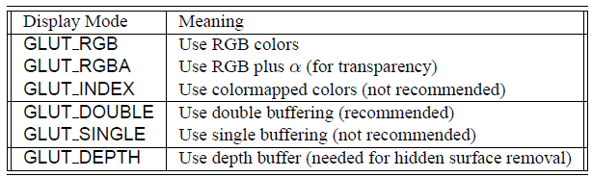
int main(int iArgc, char** cppArgv)
{
glutInit(&iArgc, cppArgv);
glutInitDisplayMode(GLUT_SINGLE | GLUT_RGB);
glutInitWindowSize(250, 250);
glutInitWindowPosition(200, 200);
glutCreateWindow("CSE_404");
Initialize();
glutDisplayFunc(Draw);
glutMainLoop();
return 0;
}

Slide 34
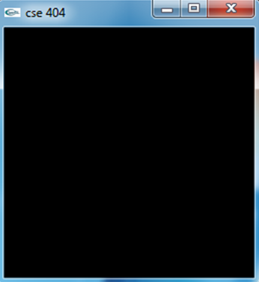
int main(int iArgc, char** cppArgv)
{
glutInit(&iArgc, cppArgv);
glutInitDisplayMode(GLUT_SINGLE | GLUT_RGB);
glutInitWindowSize(250, 250);
glutInitWindowPosition(200, 200);
glutCreateWindow("CSE_404");
Initialize();
glutDisplayFunc(Draw);
glutMainLoop();
return 0;
}
width and height of the graphics window
The general form is-glutInitWindowSize(int width, int height).
250
250

Slide 35
int main(int iArgc, char** cppArgv)
{
glutInit(&iArgc, cppArgv);
glutInitDisplayMode(GLUT_SINGLE | GLUT_RGB);
glutInitWindowSize(250, 250);
glutInitWindowPosition(200, 200);
glutCreateWindow("CSE_404");
Initialize();
glutDisplayFunc(Draw);
glutMainLoop();
return 0;
}
location of the upper left corner of the graphics window

Slide 36
int main(int iArgc, char** cppArgv)
{
glutInit(&iArgc, cppArgv);
glutInitDisplayMode(GLUT_SINGLE | GLUT_RGB);
glutInitWindowSize(250, 250);
glutInitWindowPosition(200, 200);
glutCreateWindow("CSE_404");
Initialize();
glutDisplayFunc(Draw);
glutMainLoop();
return 0;
}
creates the graphics window. The general form of the command is –
glutCreateWindowchar(*title)
where title is a character string.

Slide 37
int main(int iArgc, char** cppArgv)
{
glutInit(&iArgc, cppArgv);
glutInitDisplayMode(GLUT_SINGLE | GLUT_RGB);
glutInitWindowSize(250, 250);
glutInitWindowPosition(200, 200);
glutCreateWindow("CSE_404");
Initialize();
glutDisplayFunc(Draw);
glutMainLoop();
return 0;
}
It’s an user defined function

Slide 38
int main(int iArgc, char** cppArgv)
{
glutInit(&iArgc, cppArgv);
glutInitDisplayMode(GLUT_SINGLE | GLUT_RGB);
glutInitWindowSize(250, 250);
glutInitWindowPosition(200, 200);
glutCreateWindow("CSE_404");
Initialize();
glutDisplayFunc(Draw);
glutMainLoop();
return 0;
}
void Initialize( ) {
glClearColor(0.0, 0.0, 0.0, 0.0);
glMatrixMode(GL_PROJECTION);
glLoadIdentity();
gluOrtho2D(0, 250, 0, 250);
}

Slide 39
clears the window, by overwriting it with the background color.
glClearColor(Red, Green, Blue, Alpha).
int main(int iArgc, char** cppArgv)
{
glutInit(&iArgc, cppArgv);
glutInitDisplayMode(GLUT_SINGLE | GLUT_RGB);
glutInitWindowSize(250, 250);
glutInitWindowPosition(200, 200);
glutCreateWindow("CSE_404");
Initialize();
glutDisplayFunc(Draw);
glutMainLoop();
return 0;
}
void Initialize( ) {
glClearColor(0.0, 0.0, 0.0, 0.0);
glMatrixMode(GL_PROJECTION);
glLoadIdentity();
gluOrtho2D(0, 250, 0, 250);
}
R, G, B
0
255
0
1

Slide 40
int main(int iArgc, char** cppArgv)
{
glutInit(&iArgc, cppArgv);
glutInitDisplayMode(GLUT_SINGLE | GLUT_RGB);
glutInitWindowSize(250, 250);
glutInitWindowPosition(200, 200);
glutCreateWindow("CSE_404");
Initialize();
glutDisplayFunc(Draw);
glutMainLoop();
return 0;
}
void Initialize( ) {
glClearColor(0.0, 0.0, 0.0, 0.0);
glMatrixMode(GL_PROJECTION);
glLoadIdentity();
gluOrtho2D(0, 250, 0, 250);
}
OpenGL has a number of commands for handling matrices
glMatrixMode(mode) is used to specify current matrix

Slide 41
int main(int iArgc, char** cppArgv)
{
glutInit(&iArgc, cppArgv);
glutInitDisplayMode(GLUT_SINGLE | GLUT_RGB);
glutInitWindowSize(250, 250);
glutInitWindowPosition(200, 200);
glutCreateWindow("CSE_404");
Initialize();
glutDisplayFunc(Draw);
glutMainLoop();
return 0;
}
GL_MODELVIEW,
GL_PROJECTION, and
GL_TEXTURE
void Initialize( ) {
glClearColor(0.0, 0.0, 0.0, 0.0);
glMatrixMode(GL_PROJECTION);
glLoadIdentity();
gluOrtho2D(0, 250, 0, 250);
}

Slide 42
int main(int iArgc, char** cppArgv)
{
glutInit(&iArgc, cppArgv);
glutInitDisplayMode(GLUT_SINGLE | GLUT_RGB);
glutInitWindowSize(250, 250);
glutInitWindowPosition(200, 200);
glutCreateWindow("CSE_404");
Initialize();
glutDisplayFunc(Draw);
glutMainLoop();
return 0;
}
void Initialize( ) {
glClearColor(0.0, 0.0, 0.0, 0.0);
glMatrixMode(GL_PROJECTION);
glLoadIdentity();
gluOrtho2D(0, 250, 0, 250);
}
initialize to identity

Slide 43
int main(int iArgc, char** cppArgv)
{
glutInit(&iArgc, cppArgv);
glutInitDisplayMode(GLUT_SINGLE | GLUT_RGB);
glutInitWindowSize(250, 250);
glutInitWindowPosition(200, 200);
glutCreateWindow("CSE_404");
Initialize();
glutDisplayFunc(Draw);
glutMainLoop();
return 0;
}
void Initialize( ) {
glClearColor(0.0, 0.0, 0.0, 0.0);
glMatrixMode(GL_PROJECTION);
glLoadIdentity();
gluOrtho2D(0, 250, 0, 250);
}
glOrtho2D(left, right, bottom, top);
To set up viewing space

Slide 44
250
void Initialize( ) {
glClearColor(0.0, 0.0, 0.0, 0.0);
glMatrixMode(GL_PROJECTION);
glLoadIdentity();
gluOrtho2D(0, 250, 0, 250);
}
250
glOrtho(left, right, bottom, top);
To set up viewing space

Slide 45
250
void Initialize( ) {
glClearColor(0.0, 0.0, 0.0, 0.0);
glMatrixMode(GL_PROJECTION);
glLoadIdentity();
gluOrtho2D(0, 250, 0, 250);
}
0
0
250
glOrtho(left, right, bottom, top);
To set up viewing space

Slide 46
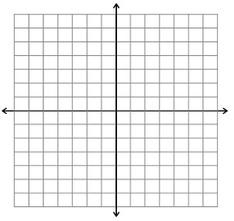
12’’
(0,0)
250

Slide 47
(250,0)
(250, 250)
void Initialize( ) {
glClearColor(0.0, 0.0, 0.0, 0.0);
glMatrixMode(GL_PROJECTION);
glLoadIdentity();
gluOrtho2D(0, 250, 0, 250);
}
(0,0)
(0,250)
glOrtho(left, right, bottom, top);
To set up viewing space

Slide 48
250
(500,0)
(500, 500)
void Initialize( ) {
glClearColor(0.0, 0.0, 0.0, 0.0);
glMatrixMode(GL_PROJECTION);
glLoadIdentity();
gluOrtho2D(0, 500, 0, 500);
}
(0,0)
(0,500)
glOrtho(left, right, bottom, top);
To set up viewing space

Slide 49
250
(1,0)
(1, 1)
void Initialize( ) {
glClearColor(0.0, 0.0, 0.0, 0.0);
glMatrixMode(GL_PROJECTION);
glLoadIdentity();
gluOrtho2D(0, 1, 0, 1);
}
(0,0)
(0,1)
glOrtho(left, right, bottom, top);
To set up viewing space

Slide 50
int main(int iArgc, char** cppArgv)
{
glutInit(&iArgc, cppArgv);
glutInitDisplayMode(GLUT_SINGLE | GLUT_RGB);
glutInitWindowSize(250, 250);
glutInitWindowPosition(200, 200);
glutCreateWindow("CSE_404");
Initialize();
glutDisplayFunc(Draw);
glutMainLoop();
return 0;
}
void Initialize( ) {
glClearColor(0.0, 0.0, 0.0, 0.0);
glMatrixMode(GL_PROJECTION);
glLoadIdentity();
gluOrtho2D(0, 250, 0, 250);
}

Slide 51
int main(int iArgc, char** cppArgv)
{
glutInit(&iArgc, cppArgv);
glutInitDisplayMode(GLUT_SINGLE | GLUT_RGB);
glutInitWindowSize(250, 250);
glutInitWindowPosition(200, 200);
glutCreateWindow("CSE_404");
Initialize();
glutDisplayFunc(Draw);
glutMainLoop();
return 0;
}
Call the user defined function that draws something on the window

Slide 52
int main(int iArgc, char** cppArgv)
{
glutInit(&iArgc, cppArgv);
glutInitDisplayMode(GLUT_SINGLE | GLUT_RGB);
glutInitWindowSize(250, 250);
glutInitWindowPosition(200, 200);
glutCreateWindow("CSE_404");
Initialize();
glutDisplayFunc(Draw);
glutMainLoop();
return 0;
}
void Draw()
{
glClear(GL_COLOR_BUFFER_BIT);
glColor3f(1.0, 1.0, 1.0);
glBegin(GL_POINTS);
glVertex2i(125, 125);
glEnd();
glFlush();
}

Slide 53
int main(int iArgc, char** cppArgv)
{
glutInit(&iArgc, cppArgv);
glutInitDisplayMode(GLUT_SINGLE | GLUT_RGB);
glutInitWindowSize(250, 250);
glutInitWindowPosition(200, 200);
glutCreateWindow("CSE_404");
Initialize();
glutDisplayFunc(Draw);
glutMainLoop();
return 0;
}
clear the window
void Draw()
{
glClear(GL_COLOR_BUFFER_BIT);
glColor3f(1.0, 1.0, 1.0);
glBegin(GL_POINTS);
glVertex2i(125, 125);
glEnd();
glFlush();
}

Slide 54
int main(int iArgc, char** cppArgv)
{
glutInit(&iArgc, cppArgv);
glutInitDisplayMode(GLUT_SINGLE | GLUT_RGB);
glutInitWindowSize(250, 250);
glutInitWindowPosition(200, 200);
glutCreateWindow("CSE_404");
Initialize();
glutDisplayFunc(Draw);
glutMainLoop();
return 0;
}
void Draw()
{
glClear(GL_COLOR_BUFFER_BIT);
glColor3f(1.0, 1.0, 1.0);
glBegin(GL_POINTS);
glVertex2i(125, 125);
glEnd();
glFlush();
}
Setting color of objects
glColor3f (R,G,B)

Slide 55
int main(int iArgc, char** cppArgv)
{
glutInit(&iArgc, cppArgv);
glutInitDisplayMode(GLUT_SINGLE | GLUT_RGB);
glutInitWindowSize(250, 250);
glutInitWindowPosition(200, 200);
glutCreateWindow("CSE_404");
Initialize();
glutDisplayFunc(Draw);
glutMainLoop();
return 0;
}
void Draw()
{
glClear(GL_COLOR_BUFFER_BIT);
glColor3f(1.0, 1.0, 1.0);
glBegin(GL_POINTS);
glVertex2i(125, 125);
glEnd();
glFlush();
}
To draw something

Slide 56
int main(int iArgc, char** cppArgv)
{
glutInit(&iArgc, cppArgv);
glutInitDisplayMode(GLUT_SINGLE | GLUT_RGB);
glutInitWindowSize(250, 250);
glutInitWindowPosition(200, 200);
glutCreateWindow("CSE_404");
Initialize();
glutDisplayFunc(Draw);
glutMainLoop();
return 0;
}
We want to draw a Point
void Draw()
{
glClear(GL_COLOR_BUFFER_BIT);
glColor3f(1.0, 1.0, 1.0);
glBegin(GL_POINTS);
glVertex2i(125, 125);
glEnd();
glFlush();
}

Slide 57
int main(int iArgc, char** cppArgv)
{
glutInit(&iArgc, cppArgv);
glutInitDisplayMode(GLUT_SINGLE | GLUT_RGB);
glutInitWindowSize(250, 250);
glutInitWindowPosition(200, 200);
glutCreateWindow("CSE_404");
Initialize();
glutDisplayFunc(Draw);
glutMainLoop();
return 0;
}
void Draw()
{
glClear(GL_COLOR_BUFFER_BIT);
glColor3f(1.0, 1.0, 1.0);
glBegin(GL_POINTS);
glVertex2i(125, 125);
glEnd();
glFlush();
}
Coordinate values of that point

Slide 58
(250, 250)
(250,0)
void Draw()
{
glClear(GL_COLOR_BUFFER_BIT);
glColor3f(1.0, 1.0, 1.0);
glBegin(GL_POINTS);
glVertex2i(125, 125)
glEnd();
glFlush();
}
(125, 125)
(0,0)
(0,250)

Slide 59
int main(int iArgc, char** cppArgv)
{
glutInit(&iArgc, cppArgv);
glutInitDisplayMode(GLUT_SINGLE | GLUT_RGB);
glutInitWindowSize(250, 250);
glutInitWindowPosition(200, 200);
glutCreateWindow("CSE_404");
Initialize();
glutDisplayFunc(Draw);
glutMainLoop();
return 0;
}
void Draw()
{
glClear(GL_COLOR_BUFFER_BIT);
glColor3f(1.0, 1.0, 1.0);
glBegin(GL_POINTS);
glVertex2i(125, 125);
glEnd();
glFlush();
}
to ensure all objects in the scene are drawn before beginning to accept user input.

Slide 60
int main(int iArgc, char** cppArgv)
{
glutInit(&iArgc, cppArgv);
glutInitDisplayMode(GLUT_SINGLE | GLUT_RGB);
glutInitWindowSize(250, 250);
glutInitWindowPosition(200, 200);
glutCreateWindow("CSE_404");
Initialize();
glutDisplayFunc(Draw);
glutMainLoop();
return 0;
}
start it running
loops within itself, processing events and triggering your callback functions when necessary

Slide 61
#include <glut.h>
void Draw( ) {
………………………………….
}
void Initialize( ) {
……………………………………….
}
int main(int iArgc, char** cppArgv) {
……………………………………
}

Slide 62
Other primitives:
GL_LINES
GL_TRIANGLES
GL_QUADS
GL_POLYGON
More primitives:
https://www.opengl.org/sdk/docs/man2/xhtml/glBegin.xml
A good online resource for openGL:
https://www.opengl.org/sdk/docs/man2/xhtml/

